Slide 1
Uninformed/Blind Search
BBM 405 – Fundamentals of Artificial Intelligence
Pinar Duygulu
Hacettepe University
Slides are mostly adapted from AIMA, MIT Open Courseware,
Manuela Veloso(CMU) and
Svetlana Lazebnik (UIUC)
CS461 Artificial Intelligence © Pinar Duygulu
Spring 2008

Slide 2

Depth-limited search
= depth-first search with depth limit l,
i.e., nodes at depth l have no successors
Recursive implementation:
CS461 Artificial Intelligence © Pinar Duygulu
Spring 2008
Notes:
Remember that depth first search could get stuck going down in the wrong path.
As a solution to this problem we can put a cutoff on the maximum depth of the path
Depth limited search is the depth first search with limited maximum depth

Slide 3
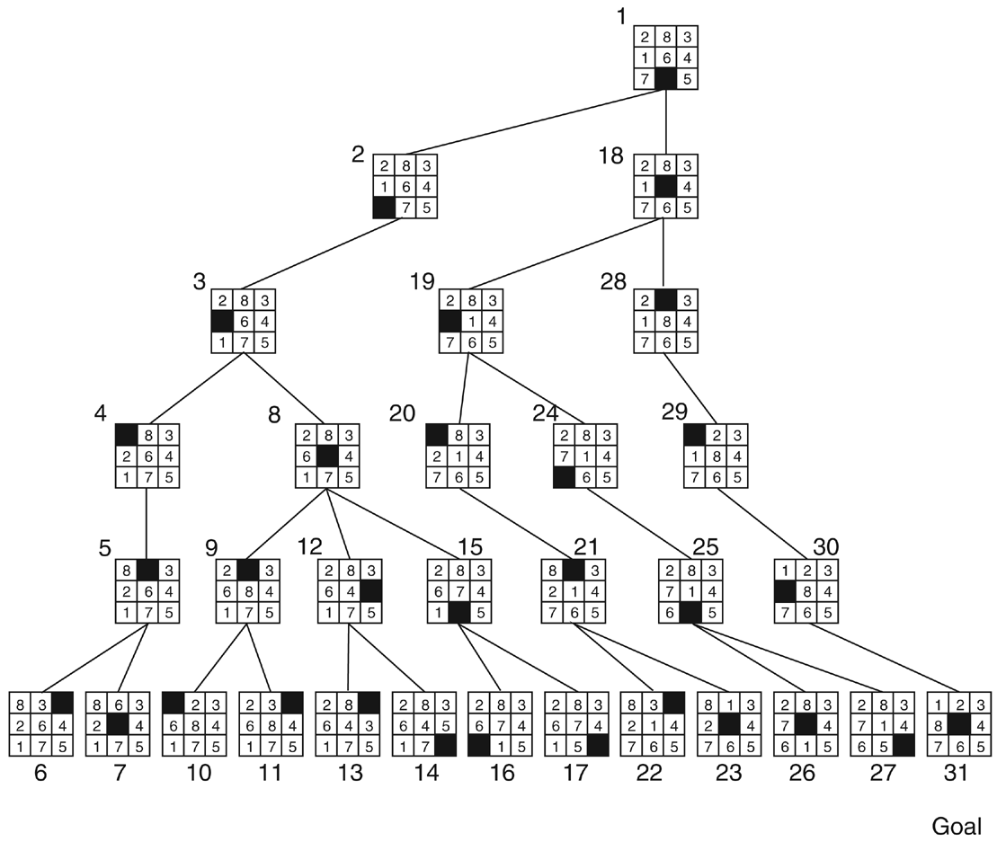
Depth limited search
Depth-first search of the 8-puzzle with a depth bound of 5.
Taken from http://iis.kaist.ac.kr/es/
CS461 Artificial Intelligence © Pinar Duygulu
Spring 2008
Notes:
For the 8-puzzle problem this is the result with depth limit 5
Do you have any suggestions to choose the limit?

Slide 4

Example: Romania
CS461 Artificial Intelligence © Pinar Duygulu
Spring 2008
Notes:
Consider the Romania map example again.
There were 20 cities. So if there is a solution it should visit at most 19 cities.
So we can say that
“if you are in city A and have travelled a path of less than 19 steps, then generate a new state in city B with a path length that is one greater”
Is there a smaller value that we can choose?
Actually yes. If you look at the map more carefully you can discover that any city can be reached from any other city in at most 9 steps
This number which we call as diameter of the state space is a better depth limit.

Slide 5

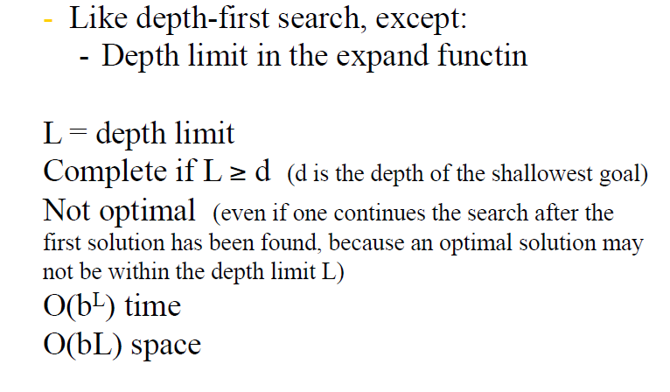
Depth limited search
Notes:
With the depth limit we can guarantee to find a solution if there exist any. Therefore it is complete
But you have to be careful about the choice of L. If you choose it too small it may not be complete
Still it is not optimal, because it cannot guarantee to find the shortest solution first.
Similar to depth first search space complexity is now O(bL) where m has been changed with the depth limit L
And the time complexity is O(b^L)
As you see choice of L is very important.
Can you suggest a way to solve this problem.
What about choosing a small L first and then if you still cannot find a solution choosing a larger L?

Slide 6
Iterative deepening search
Use DFS as a subroutine
  Check the root
  Do a DFS searching for a path of length 1
  If there is no path of length 1, do a DFS searching for a path of length 2
  If there is no path of length 2, do a DFS searching for a path of length 3…
Notes:
Actually we can do this in a more systematic way, by starting from L being 1 and continuing upto L is equal to d
until finding a solution

Slide 7
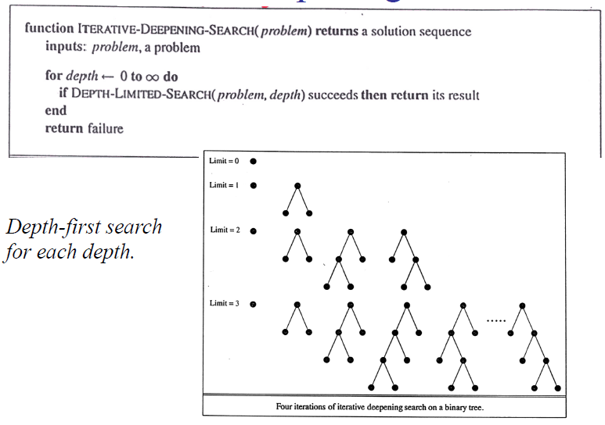
Iterative deepening search
CS461 Artificial Intelligence © Pinar Duygulu
Spring 2008
Notes:
As you see iterative deepening combines the benefits of breadfirst search and depth first search.
At each level we perform a depth first search
Therefore it is complete and optimal similar to breadth first search
But also has the advantages of depth first search

Slide 8

Iterative deepening search l =0
CS461 Artificial Intelligence © Pinar Duygulu
Spring 2008
Notes:
But what about the overhead of repetition ?
We are expanding many states multiple times
Let’s try to find the overhead
First we expand the root
That is at limit 0 only 1 node is expanded

Slide 9

Iterative deepening search l =1
CS461 Artificial Intelligence © Pinar Duygulu
Spring 2008
Notes:
At limit 1 we started from root again
Then we expand its children in the next level with branching factor b
In this case it is 2
So we expanded root and its 2 children that is 1 + 2 nodes

Slide 10

Iterative deepening search l =2
CS461 Artificial Intelligence © Pinar Duygulu
Spring 2008
Notes:
When limit is 2
We expand the grandchildren now having b^2 additional nodes
Then with limit 2 we expanded 4 additional nodes that is
1 + 2 + 4

Slide 11

Iterative deepening search l =3
CS461 Artificial Intelligence © Pinar Duygulu
Spring 2008
Notes:
At level tree we have b^3 additional nodes and so on
So we expanded 8 additional nodes
That is
1 + 2 + 4 + 8
Upto limit 3
We expanded root 4 times
Its children at level 1, 3 times
Grandchildren at level 2, 2 times
And grand grand children at level 4, only once

Slide 12
Iterative deepening search
Number of nodes generated in a depth-limited search to depth d with branching factor b:
N_{DLS} = b⁰ + b¹ + b² + … + b^{d-2} + b^{d-1} + b^{d}
Number of nodes generated in an iterative deepening search to depth d with branching factor b:
N_{IDS} = (d+1)b⁰ + d b^¹ + (d-1)b^² + … + 3b^{d-2} +2b^{d-1} + 1b^{d}
For b = 10, d = 5,
  N_{DLS} = 1 + 10 + 100 + 1,000 + 10,000 + 100,000 = 111,111
  N_{IDS} = 6 + 50 + 400 + 3,000 + 20,000 + 100,000 = 123,456
Overhead = (123,456 - 111,111)/111,111 = 11%
CS461 Artificial Intelligence © Pinar Duygulu
Spring 2008
Notes:
If we generalıze ıt to brancıng factor b and depth d
Then
Number of generated nodes for a depth first search at depth d would be
1 + b + b^2 …. b^d
Now we are generating the root (d+1), the nodes at level 1 d times, and the leaf nodes only once.
Although this looks like a huge overhead
When we consider an example with brancing factor 10 and depth 5
Actually the overhead is only 11%

Slide 13
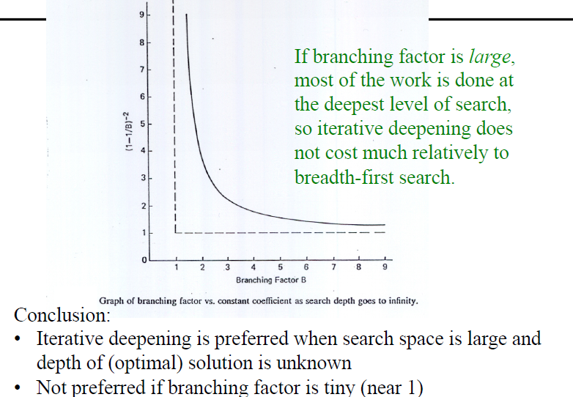
Iterative deepening search
Notes:
And we see that when the branching factor is large since most of the work is done at deeper levels
Iterative search is preferable if the depth is unkbnown

Slide 14
Properties of iterative deepening search
Complete? Yes
Time? (d+1)b⁰ + d b¹ + (d-1)b² + … + b^{d} = O(b^{d})
Space? O(bd)
Optimal? Yes, if step cost = 1
CS461 Artificial Intelligence © Pinar Duygulu
Spring 2008
Notes:
Overalll iterative deepening search has the advantages of being complete and optimal, as well as having a nice space complexity
And only disadvantage is a small increase on the time complexity

